Slide 1

FUNDAMENTALS
TEAM 3 IMS 13.3
Presented by
Shailendra Kumar Sahu
Sramona Bose
Shubham Kumar Singh
Ritika Rao
Shubhangee Kanade
Praveena Mohan
Notes:
O Logo de espadas deve ter mais espaço das pontas abaixo. Sugerir outros tipos de imagens/ telefone, fones.

Slide 2
INDEX
Fundamentals Of Hardware
Windows Fundamentals
Linux Fundamentals
Network Fundamentals
Network Services
Databse Fundamentals
Storage
Applicatons
Windows Essentials
Linux Essentials
Network Essentials
Virtualisation

Slide 3
Fundamentals Of
Hardware
Notes:
O Logo de espadas deve ter mais espaço das pontas abaixo. Sugerir outros tipos de imagens/ telefone, fones.

Slide 4
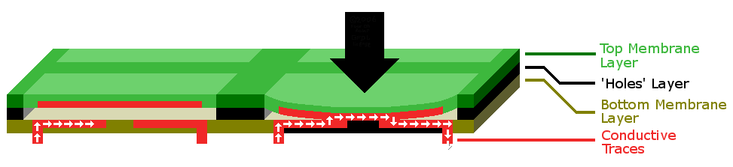
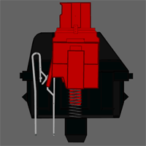
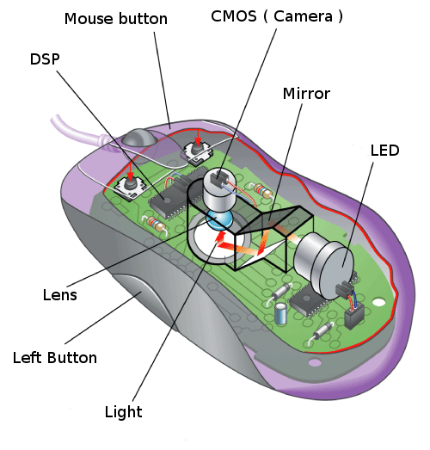
Input Devices
MEMBRANE KEYBOARD
MECHANICAL KEYBOARD
OPTICAL MOUSE
Notes:
Fixar a posicao do titulo – sempre do lado esquerdo.
Sempre que tiver muito texto o coluna deve sempre ser “ narrowed” , se nao fica dificil de ler. Colocar paragrafos no texto.
Linha vertical deve ser mais fina e as pontas NUNCA devem ser arredondadas.

Slide 5
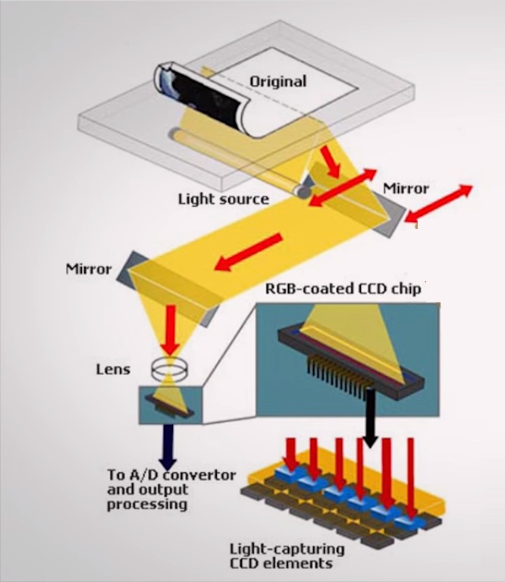
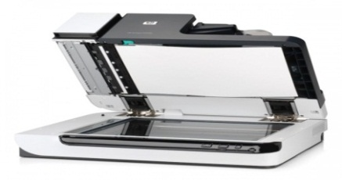
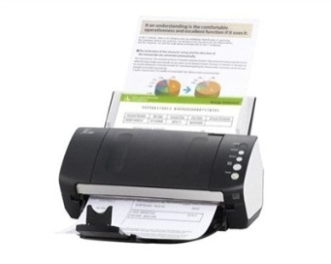
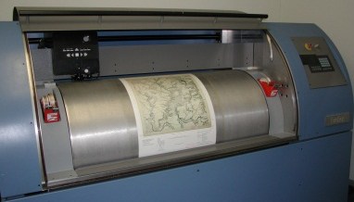
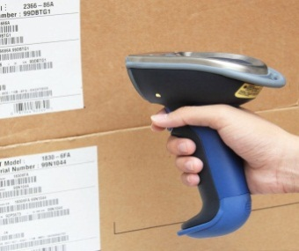
SCANNER
TYPES
Flatbed Scanner
Sheetfed Scanner
Drum Scanner
Handheld Scanner
Notes:
Fixar a posicao do titulo – sempre do lado esquerdo.
Sempre que tiver muito texto o coluna deve sempre ser “ narrowed” , se nao fica dificil de ler. Colocar paragrafos no texto.
Linha vertical deve ser mais fina e as pontas NUNCA devem ser arredondadas.

Slide 6
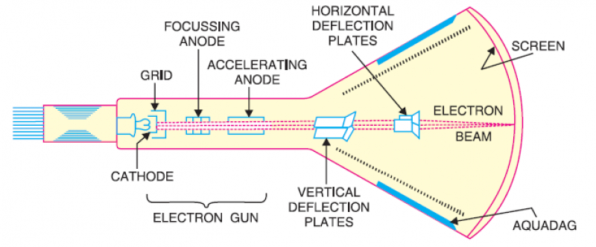
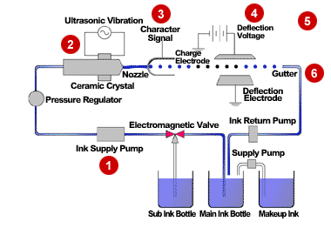
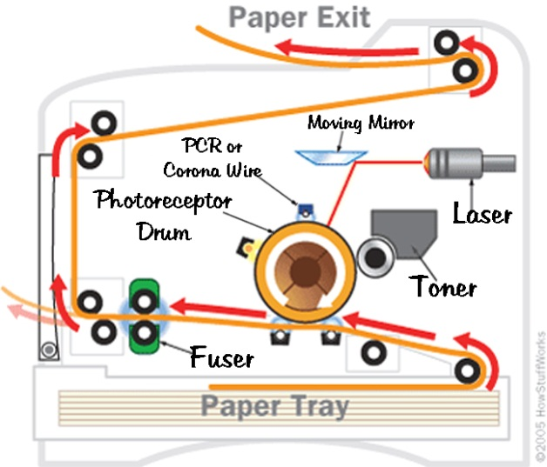
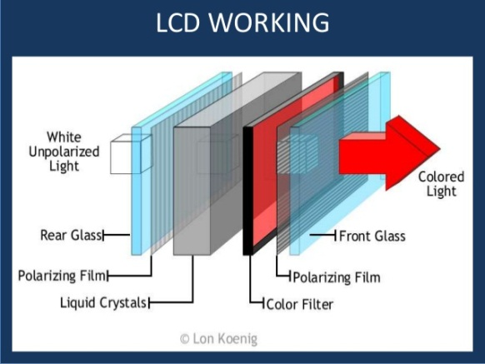
OUTPUT DEVICES
Monitor
Printer
CRT
INKJET
LASER
Notes:
Fixar a posicao do titulo – sempre do lado esquerdo.
Sempre que tiver muito texto o coluna deve sempre ser “ narrowed” , se nao fica dificil de ler. Colocar paragrafos no texto.
Linha vertical deve ser mais fina e as pontas NUNCA devem ser arredondadas.

Slide 7
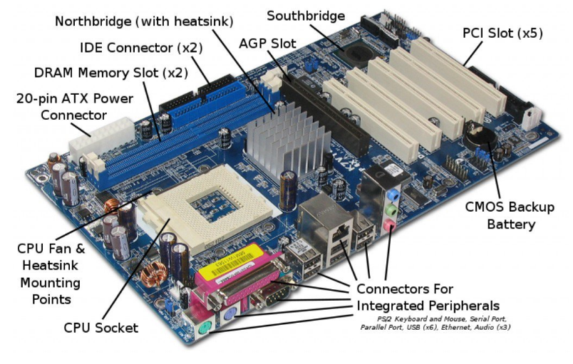
MOTHERBOARD
Notes:
Fixar a posicao do titulo – sempre do lado esquerdo.
Sempre que tiver muito texto o coluna deve sempre ser “ narrowed” , se nao fica dificil de ler. Colocar paragrafos no texto.
Linha vertical deve ser mais fina e as pontas NUNCA devem ser arredondadas.

Slide 8
Types of Memory
MEMORY
ROM
RAM
PROM
EPROM
EEPROM
SRAM
DRAM
Notes:
Fixar a posicao do titulo – sempre do lado esquerdo.
Sempre que tiver muito texto o coluna deve sempre ser “ narrowed” , se nao fica dificil de ler. Colocar paragrafos no texto.
Linha vertical deve ser mais fina e as pontas NUNCA devem ser arredondadas.

Slide 9
WINDOWS
FUNDAMENTALS
Notes:
O Logo de espadas deve ter mais espaço das pontas abaixo. Sugerir outros tipos de imagens/ telefone, fones.

Slide 10
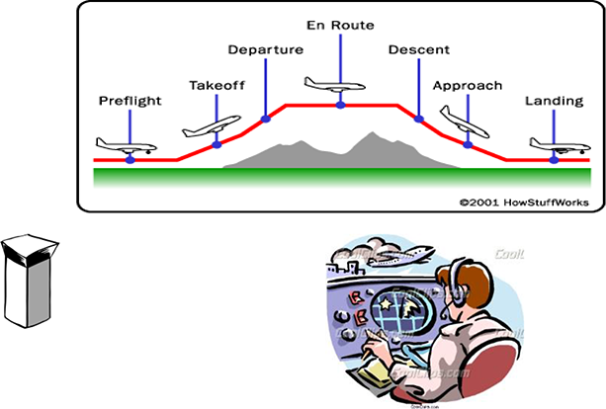
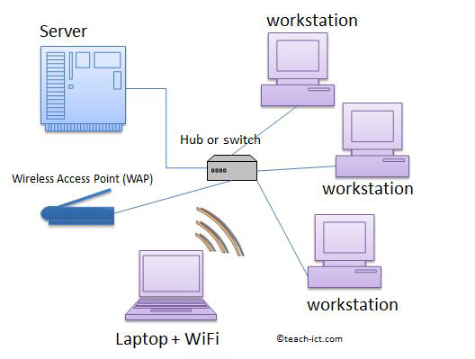
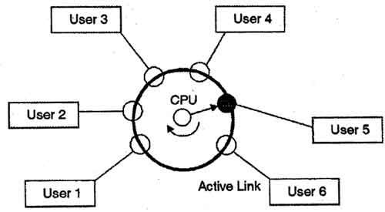
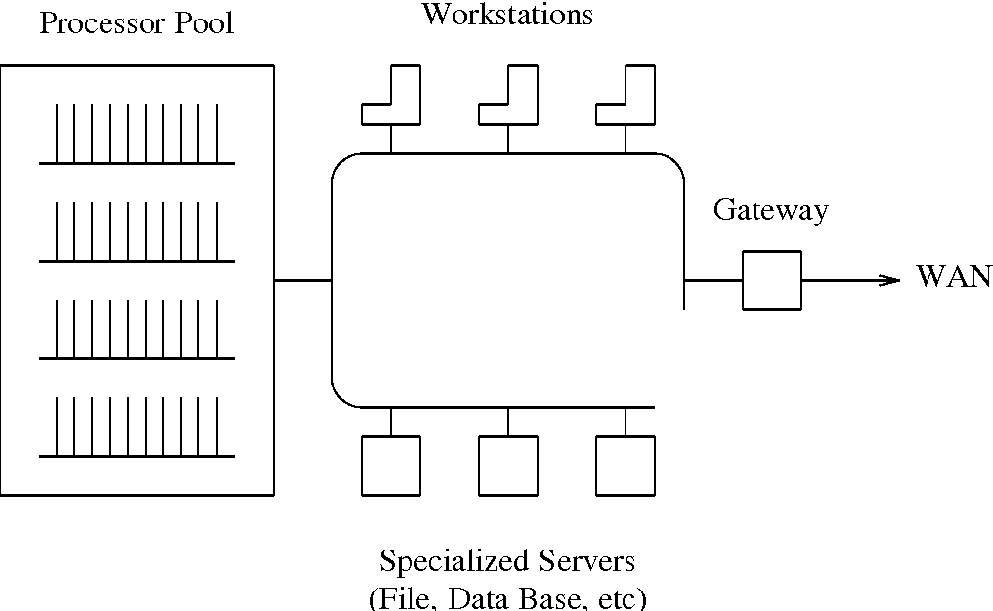
TYPES OF OPERATING SYSTEM
Real time OS
Network OS
Distributed OS
Multitasking OS

Slide 11




KERNEL ARCHITECTURE
Logon Process Winlogon.exe
Win32 Application
Local Security Authority (LSA)
USER MODE
Win32 Subsystem
Security Accounts Manager (SAM)
EXECUTIVE SERVICES
I/O Manager
Local Procedure Call
Power Manager
Process and Thread Manager
Security Reference Monitor
Configuration Manager (Registry)
Object Manager
Memory Manager
Plug and Play Manager
Kernel Transaction Manager
Cache Manager
Windows Manager
KERNEL MODE
File System
Kernel
Network Drivers
GDI
Hardware Abstraction Layer
Device Drivers
Graphics Drivers
HARDWARE

Slide 12
BOOTING PROCESS
SMPS
Power Good
Signal
Processor
Bios Initialization
OS Loader
Kernal Initialization
Session Initialization
Winlogon Initialization
Explorer Initialization
POST
Boot Priority
MBR
Boot Sector
Boot Manager
Boot Loader
(winload.exe)
Phase 0
Session 0
wininit.exe
services.exe
lsass.exe
logonui.exe
Loads HKCU registry
dwm.exe
userinit.exe
explorer.exe
Phase 1
Session 1
winlogon.exe
Ntoskernal.exe
Open known dlls(ex. hal.dll)
Initialize executive services
Loads System drivers
Loads registers

Slide 13
FILE SYSTEM
FAT
Boot Sector | Reserved Sectors | FAT 1 | FAT 2 (Duplicate) | Root Folder | Other Folders and All
NTFS
NTFS Boot Sector | Master File Table | File System Data | Master File Table Copy

Slide 14
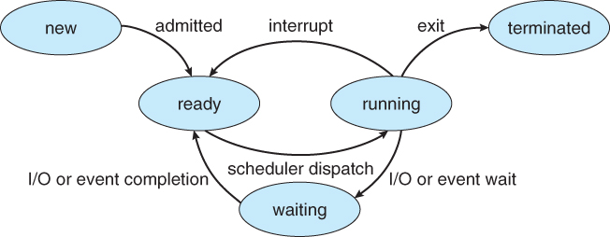
PROCESS MANAGEMENT

Slide 15
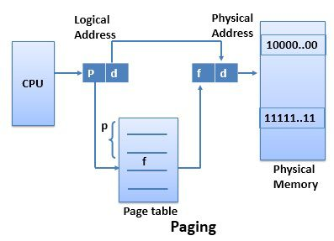
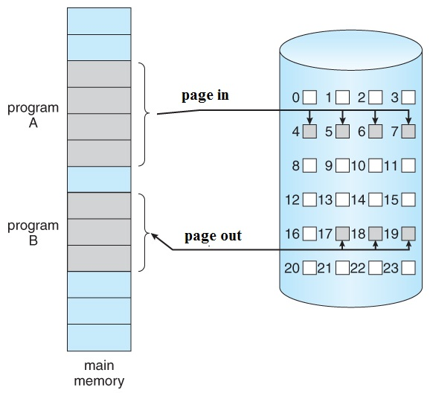
MEMORY MANAGEMENT

Slide 16
LINUX
FUNDAMENTALS

Slide 17
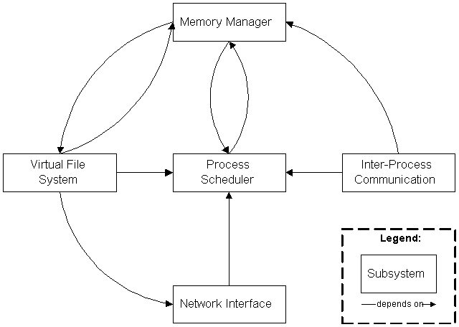
KERNEL AND ITS SUBSYSTEMS

Slide 18
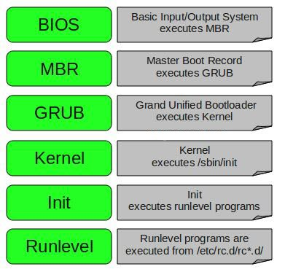
BOOTING PROCESS

Slide 19
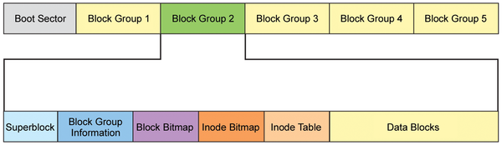
FILE SYSTEM
Ext 2
Ext 3
Ext 4
TYPES OF JOURNALING
Write back
Ordered
Data

Slide 20
PROCESS MANAGEMENT
TYPES OF PROCESS SCHEDULING
FCFS (First Come First Serve)
SJF (Shortest Job First)
Round Robin Priority Scheduling.
Types of Processes:
Init Process
Parent Process
Child Process
Zombie Process
Orphan Process
Interactive Process
Daemon Process
Real-time Process

Slide 21
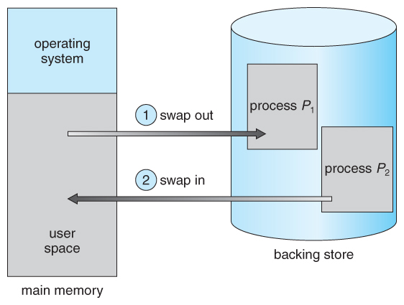
MEMORY MANAGEMENT
Components of Memory Management : Memory mapping.
Demand Paging.
Swapping: Swap-in and Swap-out

Slide 22
NETWORK
FUNDAMENTALS
Notes:
O Logo de espadas deve ter mais espaço das pontas abaixo. Sugerir outros tipos de imagens/ telefone, fones.

Slide 23
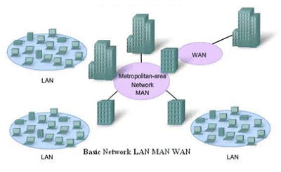
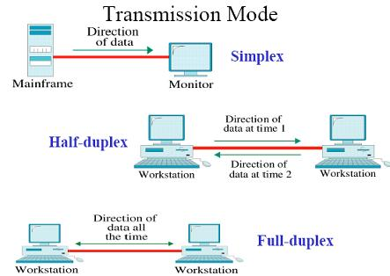
NETWORK & COMMUNICATION TYPES
Network Types Communication Types
1. LAN 1. Simplex
2. WAN 2. Half Duplex
3. MAN 3. Full Duplex

Slide 24
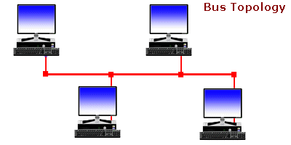
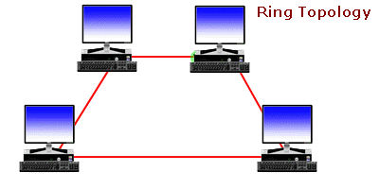
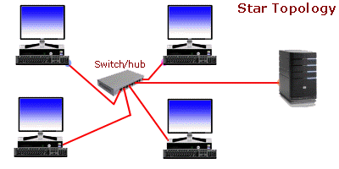
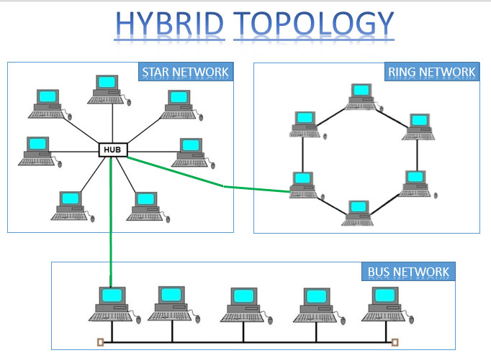
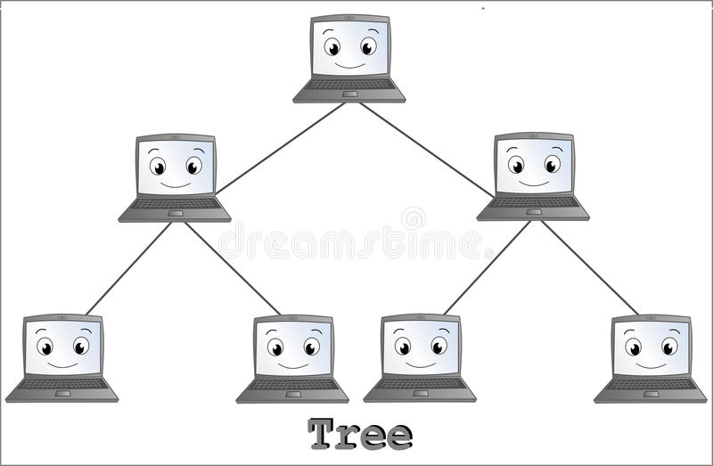
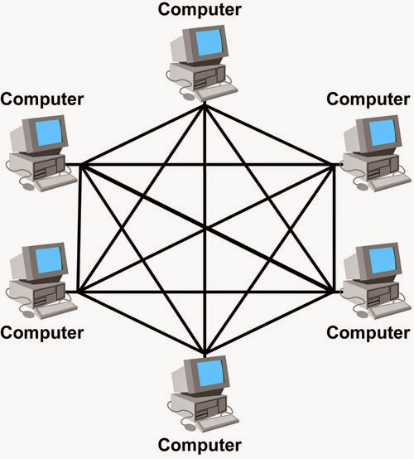
Network Topologies
Full Mesh Topology
Tree Topology

Slide 25
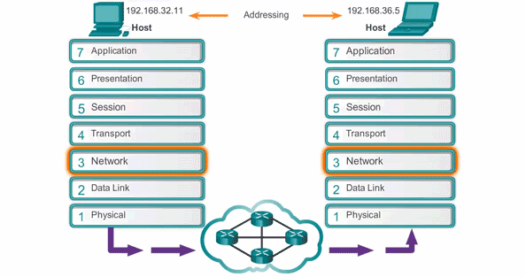
Complete OSI layer Protocol

Slide 26
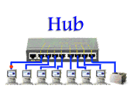
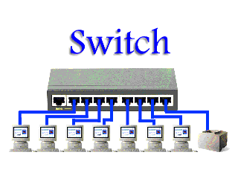
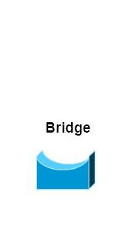
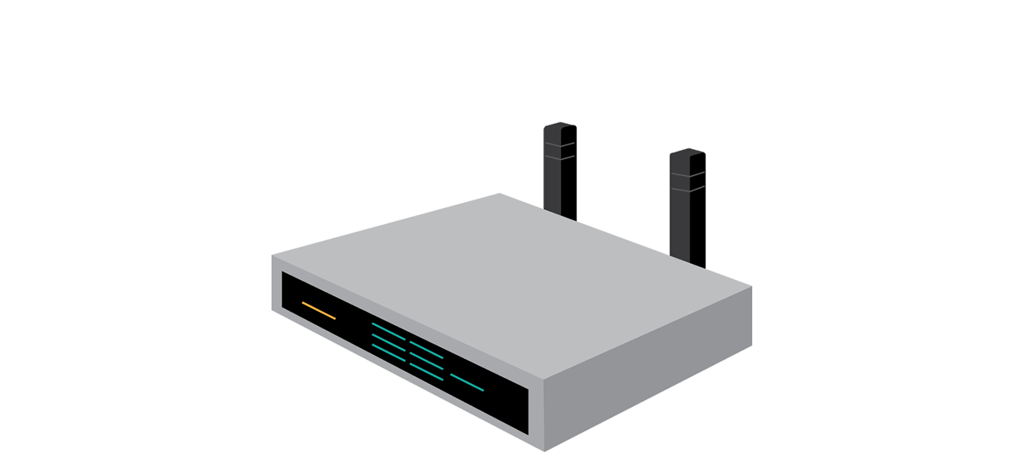
Components
Router

Slide 27
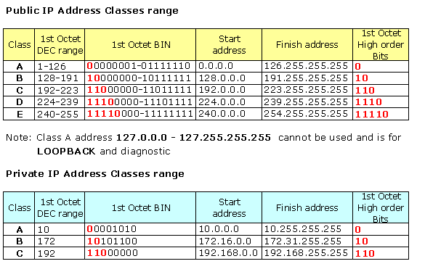
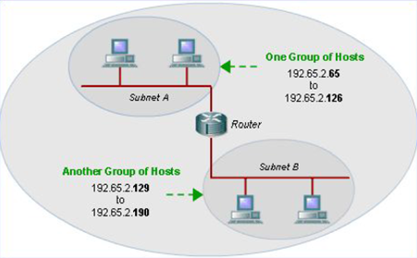
IP ADDRESS CLASSES
IP(Internet Protocol) Address is logical address which is given to the devices connected to the network.
SUBNETTING
Subnetting is a process of dividing a large network into smaller networks.

Slide 28
NETWORK SERVICES
Notes:
O Logo de espadas deve ter mais espaço das pontas abaixo. Sugerir outros tipos de imagens/ telefone, fones.

Slide 29
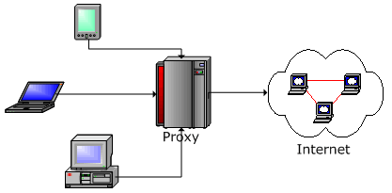
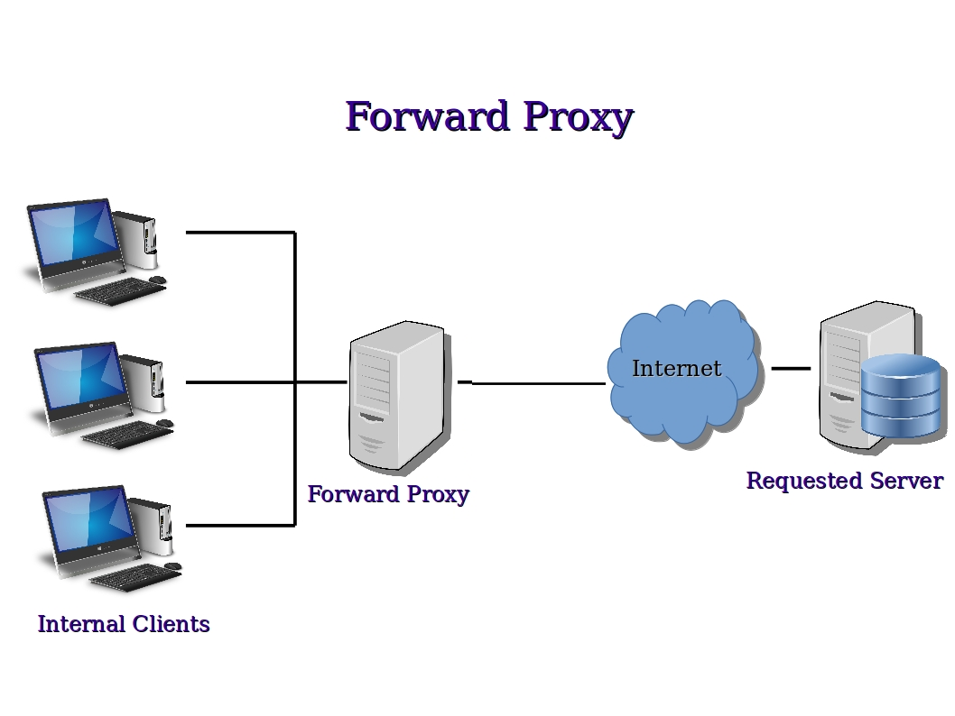
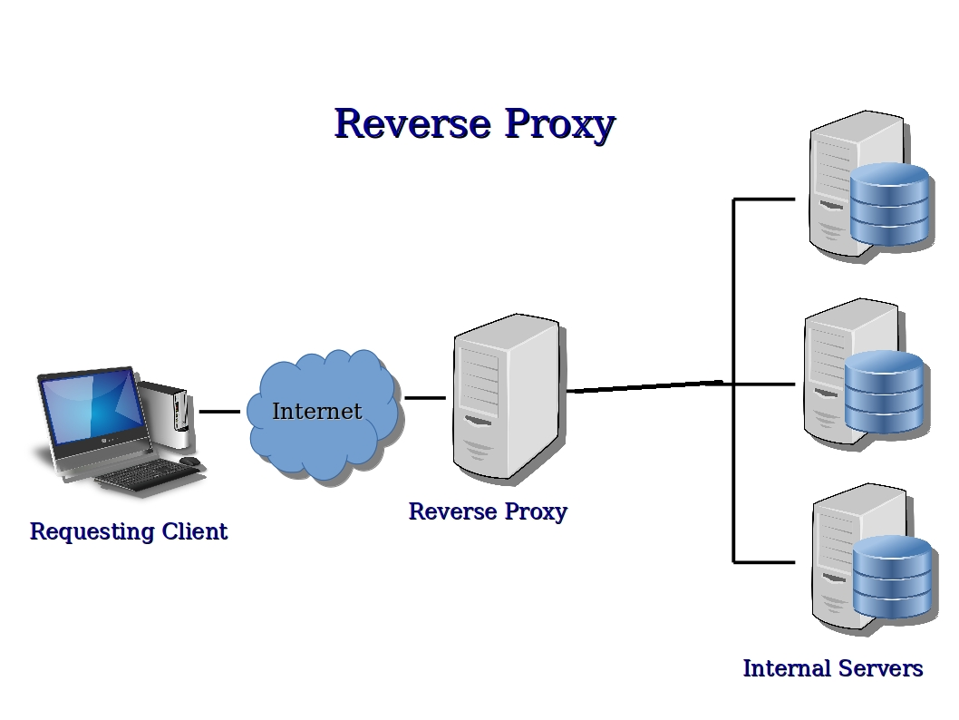
Proxy
Acts as an intermediary between the user's computer and the Internet
Types of Proxy :

Slide 30
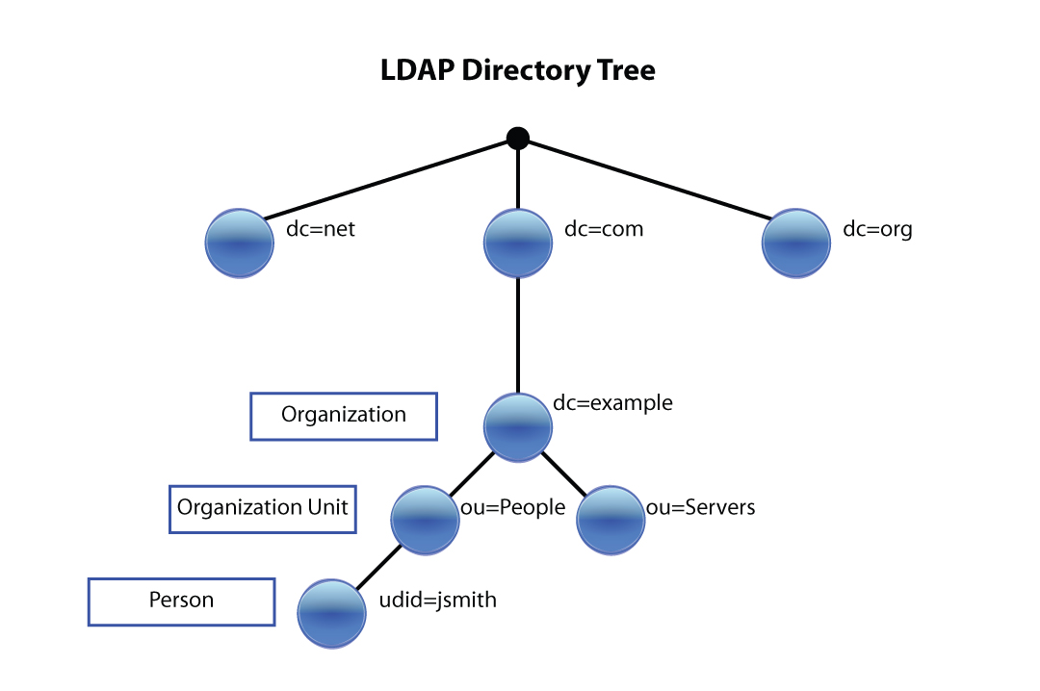
Directory Services
Directory services contain data and metadata
X.500 formed the basis of a standard that is widely deployed known as LDAP.
LDAP

Slide 31
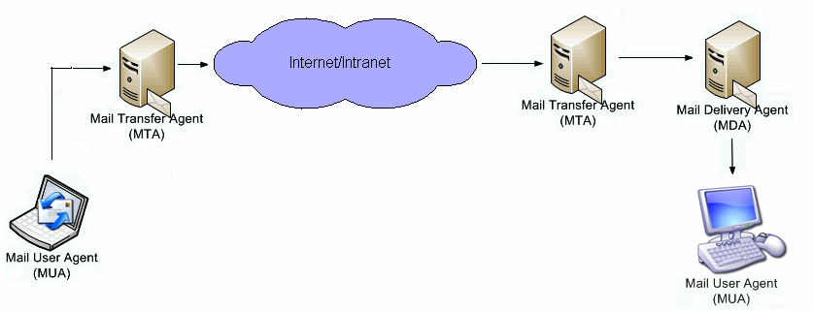
Mail Services
SMTP
SMTP
SMTP
Pop / IMAP

Slide 32
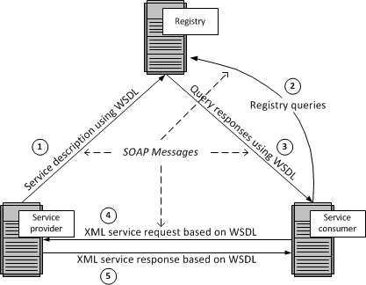
Web Services
Any piece of software that makes itself available over internet & uses a standardized XML messaging system.

Slide 33

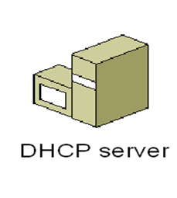
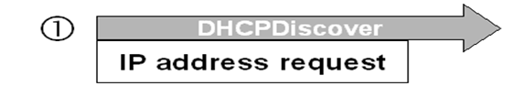
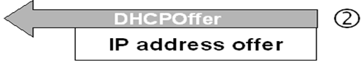
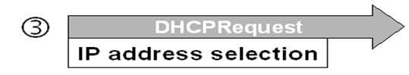
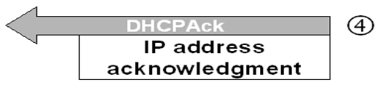
Dynamic Host Configuration Protocol (DHCP)
Used to dynamically assign an IP address to any node
DORA PROCESS
DHCP ALLOCATION MACHANISM:
Manual allocation
Automatic allocation
Dynamic allocation

Slide 34


Domain Name Server (DNS)
Translates a domain name into corresponding IP address
DNS Hierarchy
74.125.225.74
192.168.1.2
DNS Query
Recursive Query
Iterative Query
DNS Records
A / AAAA
CNAME
PTR

Slide 35



DNS Working
1. Query for www.google.com
2. Query to root server for “.com”
2. www.google.com is at 10.120.11.122
7. www.google.com is at 10.120.11.122
Your workstation
(user enter “www.google.com”)
Your ISP
Internet Root Server
5. Query for www.google.com
3. Query for IP address of “google.com” server
4. “google.com” is at 10.120.11.122
8. Requesting for Webpage
6. www.google.com is at 10.120.11.122
.com
.in
.gov
Google’s DNS
Top level Domain servers

Slide 36
DATABASE FUNDAMENTALS
Notes:
O Logo de espadas deve ter mais espaço das pontas abaixo. Sugerir outros tipos de imagens/ telefone, fones.

Slide 37


Database
Organized collection of data

Slide 38


RDBMS
DBMS that is based on the relational model as introduced by E. F. Codd.
DBMS vs. RDBMS
Attributes
Terminology of RDBMS
SQL constraints :
NOT NULL
DEFAULT
UNIQUE
CHECK
PRIMARY KEY
FOREIGN KEY
Relation
Tuples
Domain

Slide 39
EF Codd Rules
FOUNDATION RULE
Rule 0: Foundation Rule
Rule 12: No Subversion Rule
STRUCTURAL RULE
Rule 1: Information Representation
Rule 6: View Updating
INTEGRITY RULE
Rule 3: Systematic Treatment of Null Value
Rule 10: Integrity Independence
DATA MANIPULATION RULE
Rule 2: Guaranteed Access
Rule 4: Dynamic Online Catalog
Rule 5: Comprehensive Data Sublanguage
Rule 7: High-Level insert, update, delete
DATA INDEPENDENCE RULE
Rule 8: Physical Data Independence
Rule 9: Logical Data Independence
Rule 11: Distribution Independence

Slide 40
Normalization
Normalization is the process of minimizing redundancy from a relation
Types :
1NF
2NF
3NF
Brand | Color | Price | Tax
Polo | White, Black | 1500 | 5.0
Zara | Red, Yellow | 1200 | 2.0
Levis | Blue, Black | 1200 | 2.0
Brand | Price
Polo | 1500
Zara | 1200
Levis | 1200
Brand | Color | Price | Tax
Polo | White | 1500 | 5.0
Polo | Black | 1500 | 5.0
Zara | Red | 1200 | 2.0
Zara | Yellow | 1200 | 2.0
Levis | Blue | 1200 | 2.0
Levis | Black | 1200 | 2.0
Brand | Color
Polo | White
Polo | Black
Zara | Red
Zara | Yellow
Levis | Blue
Levis | Black
Brand | Color
Polo | White
Polo | Black
Zara | Red
Zara | Yellow
Levis | Blue
Levis | Black
Brand | Price | Tax
Polo | 1500 | 5.0
Zara | 1200 | 2.0
Levis | 1200 | 2.0
Price | Tax
1500 | 5.0
1200 | 2.0
1200 | 2.0
1NF: Remove multiple values in single cell
3NF: Remove Transitive Dependency
2NF: Remove Partial Dependency

Slide 41
STORAGE

Slide 42



Storage Types

Slide 43



RAID
(Redundant array of independent disc)

Slide 44
APPLICATION

Slide 45
Introduction
Components of Application
Presentation logic
Business logic
Data persistence logic
Life cycle of application:
Performance Tuning & Optimization
Maintenance
Crash Recovery
Migration
Deployment

Slide 46
Application
Types of application:
Compiled
Interpreted
Application Programming Interface:
An application program interface (API) is code that allows two software programs to communicate with each other.

Slide 47
Application architecture types:
Thick client
Thin client
Rich internet
Tier:
2 tier application
3 tier application
Presentation/ Business
Database
Two tier architecture
Presentation
Business
database
Three tier architecture

Slide 48
WINDOWS ESSENTIALS
Notes:
O Logo de espadas deve ter mais espaço das pontas abaixo. Sugerir outros tipos de imagens/ telefone, fones.

Slide 49

WINDOWS SERVER 2012 R2
Roles of Windows Sever 2012R2
1. ADDS
2. FSRM
3.WDS
4.IIS
Active Directory Domain Service
File Server Resource Management
Windows Deployment Service
Internet Information Services

Slide 50
Linux Essentials

Slide 51

User and Group Permission
File Management
Sr. No. | Command | Meaning
1. | Setfacl and getfacl | Setfacl : sets file access control lists. getfacl : display file access control lists.
2. | chmod | To change permissions on a file or directory
3. | chgrp | To change group ownership.
Disk Management
Sr. No. | Command | Meaning
1. | mkdir and rmdir | mkdir : Make directory rmdir : remove directory
2. | touch | To create file
3. | Ls | To list out all files and directory

Slide 52
Process
ps -a : List all the running / active processes.
Top : monitor the system as it shows the system resources used by different processes.
nice <priority value> <process name> : starts the process by setting its priority to the given value.
renice -n -p : change the priority of the given process.

Slide 53
Network Essentials

Slide 54


Switching
VLAN Protocols

Slide 55


Routing Protocols

Slide 56


ACL
Redistribution

Slide 57

Network Address Translation

Slide 58
Virtualization

Slide 59

Virtualization
It refers to the act of creating a virtual version of something, including virtual computer hardware platforms, storage devices, and computer network resources.
It allows to run multiple OS on a single system.
Why Virtualization?
Reduce capital and operating cost.
Eliminate downtime
Enable business continuity and disaster recovery
Simplify data center management

Slide 60

Hypervisior
A hypervisor is a hardware virtualization technique that allows multiple guest operating systems (OS) to run on a single host system at the same time.
Types of Hypervisior?
Bare-metal
Para

Slide 61

vCenter Server
VMware vCenter Server provides a centralized platform for managing your VMware vSphere environments.

Slide 62

Openfiler
Openfiler provides key features such as iSCSI target for virtualization, Fibre Channel target support, block level replication and High Availability

Slide 63
Thank You

